Slide 1
Search and Replace Text
A LINUX MINI PROJECT

Slide 2




GROUP MEMBERS
Aditya Iche
Mohsin Khan
Siddhesh Desai
Sarthak Munguskar
202401100136
202401100126
202401100145
202401100118

Slide 3
Introduction
The inspiration for this project came from a real-world scenario while working on our Linux assignments. We noticed that several of our shell scripts contained a generic error message that lacked clarity for users. To enhance the user experience, we decided to replace this error message with a more descriptive usage message. However, manually updating multiple scripts was tedious and error-prone, leading us to develop this program.

Slide 4
Key Features of Mini Project:
1
2
3
Bulk Text Replacement Across Multiple Files
Flexible Usage
Detailed Summary Report
Supports any file type, making it versatile for scripts, configuration files, or codebases.
Provides an overview of processed files, replacements made, and files modified.
Quickly find and replace text in numerous files simultaneously, saving time and effort.

Slide 5
How it works:
Search and Replace Process
Input Validation
Backup Creation
The script checks if the correct number of arguments is provided (search text, replacement text, and files to process). If not, it displays a usage message.
Before modifying files, the script creates backups in a timestamped directory to safeguard original content
Each file is scanned for occurrences of the search text.
If matches are found, the script uses the sed command to replace the text.
Files with changes are counted, and the number of replacements is tallied.

Slide 6
How it works:
Error Handling
Summary Report
Invalid or non-regular files are skipped with a descriptive error message.
After processing, the script provides a detailed summary, including the total number of files processed, files modified, and replacements made.

Slide 7
Use of Mini Project:
1
2
3
Version Control and Backups
Code Refactoring
Automating repetitive tasks
Ideal for updating variables, function names, or error messages in programming projects, ensuring consistency across the codebase
Creates backups of original files before modification, ensuring data safety and traceability.
This project is a practical solution for automating repetitive tasks, enhancing productivity, and maintaining accuracy in file management workflows.

Slide 8
Program
Lets switch to Linux to demonstrate our mini project!!!

Slide 9
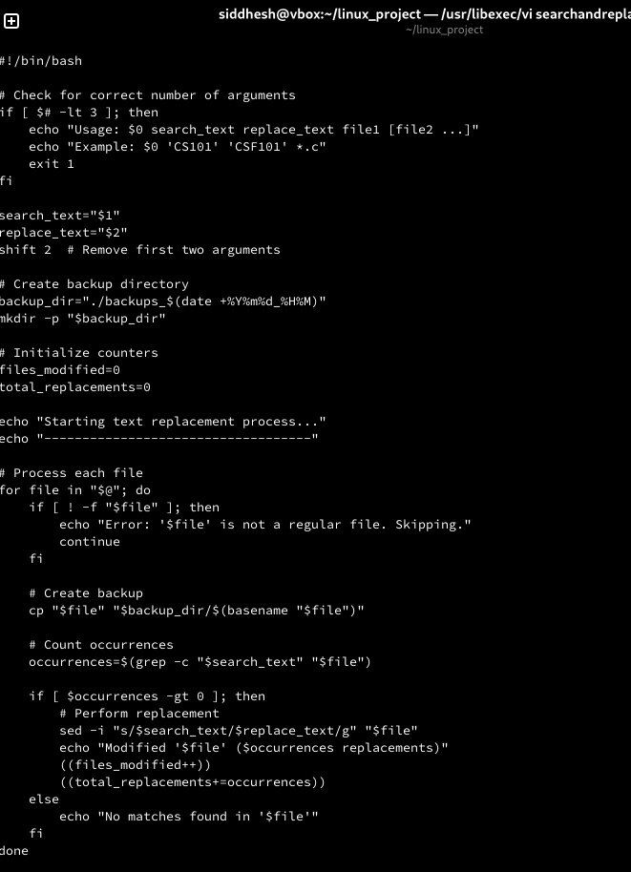
Code:

Slide 10
Code:

Slide 11
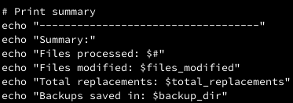
Code:

Slide 12
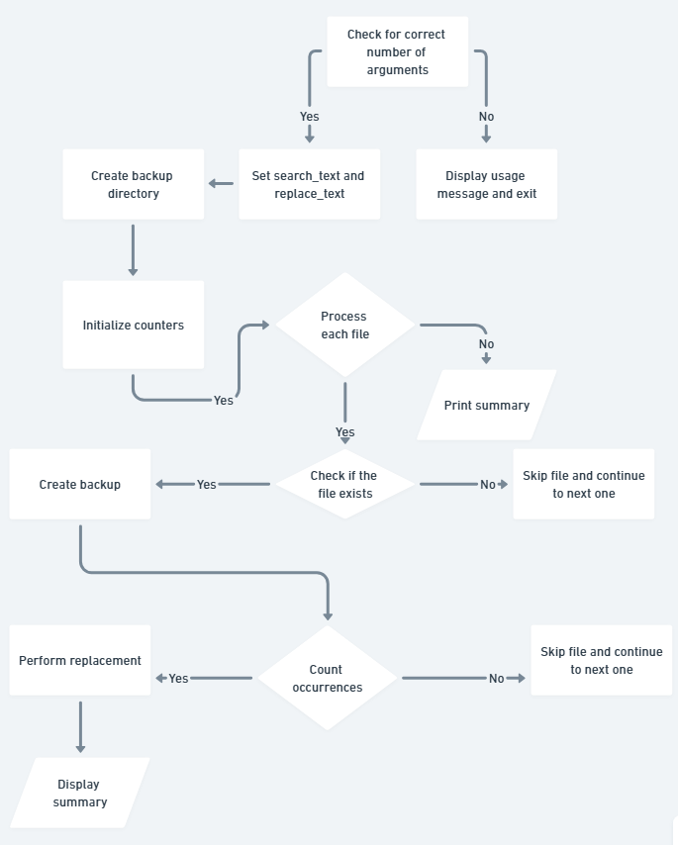
Flowchart:

Slide 13
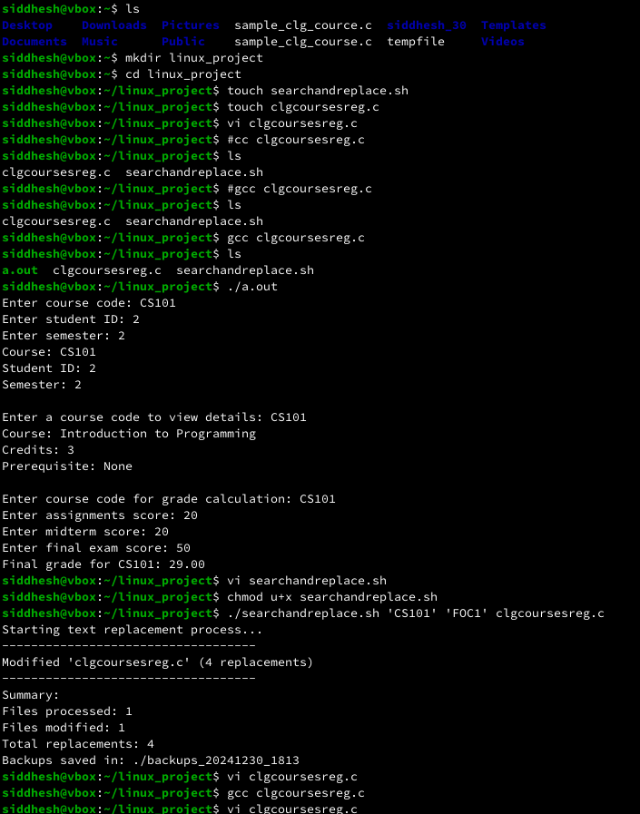
Execution:

Slide 14
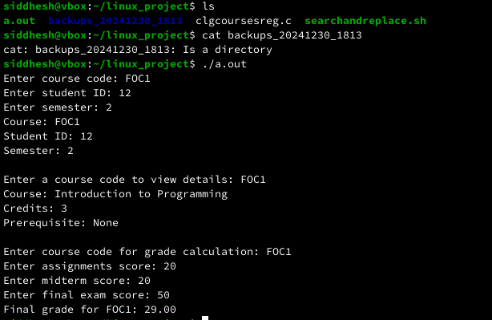
Execution:

Slide 15
Execution:

Slide 16
Results:
Successful Update
Efficiency
Backup Creation
The course code change from "CS101" to "FOC1" was successfully applied across multiple C files, ensuring consistency
The script saved time by automating the process of updating the course code in all related files, rather than editing each file manually
Backups of all modified files were created, ensuring data safety and easy restoration if needed

Slide 17

Future Scope:
User Interface (UI)
Cross-Platform Support
Develop a graphical user interface (GUI) to make the tool more accessible for non-technical users, expanding its reach and usability
Extend compatibility to other operating systems, like Windows and macOS, ensuring the tool works in various environments beyond Linux.
Version Control Integration
Advanced Backup System
Integrate with version control systems like Git to automate commit creation and track changes, simplifying the process of managing modifications in collaborative projects
Introduce versioned backups, allowing users to revert to specific versions of modified files, providing more control over changes

Slide 18
Conclusions:
The Linux mini project was designed to automate the process of searching and replacing specific text across multiple files, which proved to be highly effective in achieving its goal. By using a simple shell script, the project successfully streamlined the task of making bulk text changes, such as updating course codes in C program files. The script efficiently handled multiple files at once, minimizing manual effort and reducing the potential for human error. It also ensured data safety by creating backups of all modified files. Overall, the project was successful in automating a common yet tedious task, saving time, improving accuracy, and demonstrating the power of shell scripting for real-world applications

Slide 19
THANK YOU

